Slide 1
MULTIPLE DISEASE PREDICTION SYSTEM
Priyanka Kala
JECRC Foundation

Slide 2
Introduction
The Multiple Disease Prediction System' is a web-based application designed to predict the likelihood of various diseases based on user-input symptoms. This system uses machine learning algorithms to analyze the symptoms and provide users with a probable diagnosis, helping in the early detection of diseases.
The primary objective of this project is to develop a user-friendly and efficient tool that can predict multiple diseases with high accuracy. The system aims to be a preliminary diagnostic tool that helps users gain insights into their health conditions, thereby encouraging them to seek timely medical advice.

Slide 3
System Architecture
User Input
Data Processing
Model Prediction
Displaying results

Slide 4
Technology Stack
Programming Language: Python
Framework: Streamlit for the web interface.
Libraries Used:
Pandas and NumPy – Data Manipulation.
Scikit-learn - Machine Learning models.
Streamlit - Building the application interface.

Slide 5
Components of Project
Front-End
Streamlit
Back-End
Machine Learning Algorithms
Support Vector Machine
Logistic Regression

Slide 6

Front-End
Streamlit
Streamlit is a free and open-source framework for quickly creating and sharing visually appealing machine learning and data science web apps. It is a Python-based library created primarily for machine learning developers.
With Streamlit, one can create a visually appealing application with just a few lines of code.
Streamlit supports with Python 3.8 version and beyond
Command to install Streamlit : pip install streamlit
Streamlit_option_menu is used for creating the sidebar or navigation bar

Slide 7
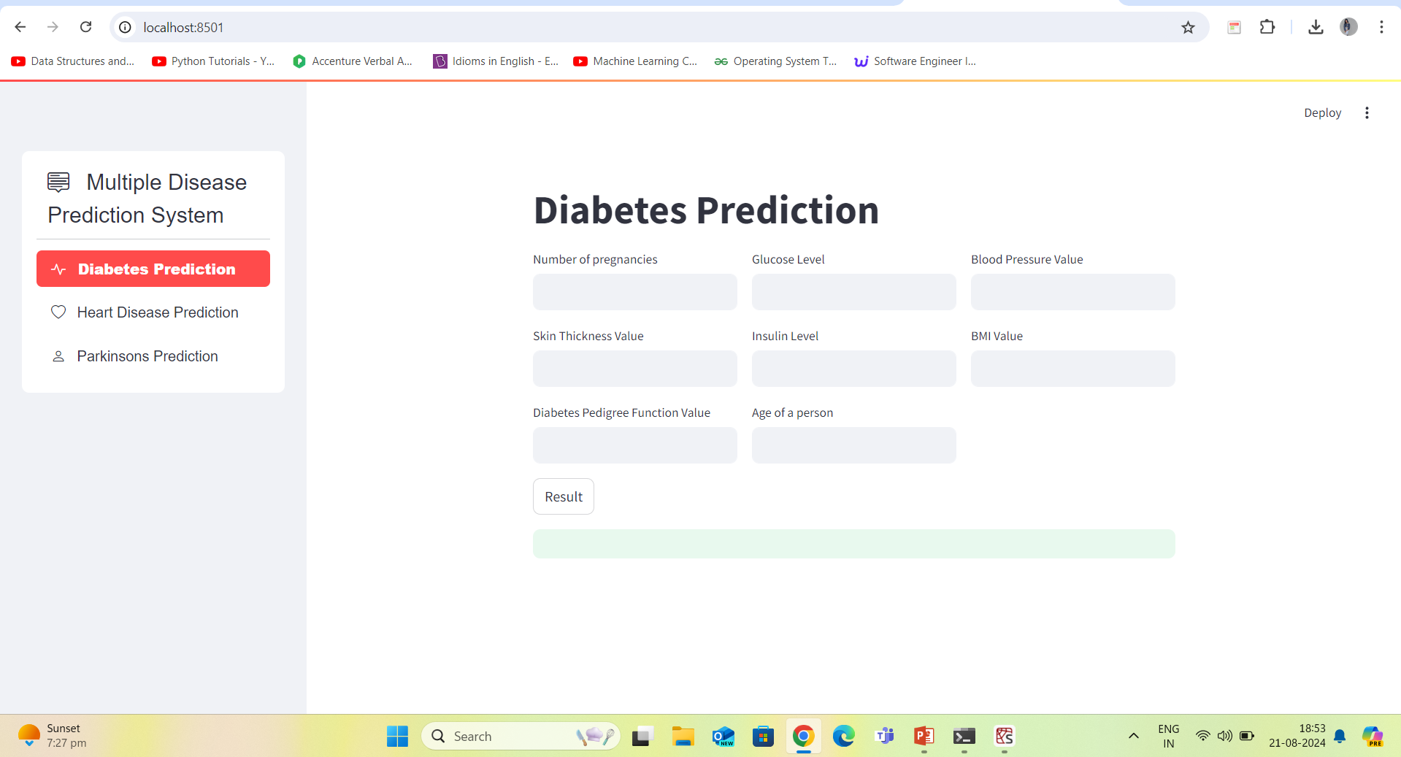

Slide 8
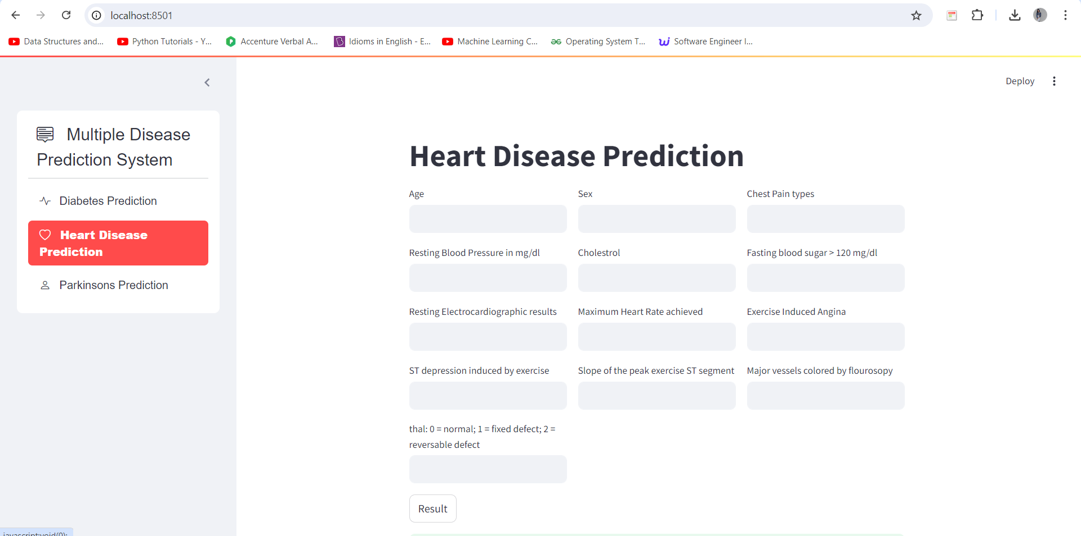
Sidebar
Text-Field
Disease pane
Features
Result Button

Slide 9
Back - End
Machine Learning Algorithms
A machine learning algorithm is a set of rules or processes used by an AI system to conduct tasks—most often to discover new data insights and patterns, or to predict output values from a given set of input variables. Algorithms enable machine learning (ML) to learn.
ML Algorithms
Supervised
Unsupervised
Reinforcement

Slide 10

Machine Learning Algorithms
Support Vector Machine
Support Vector Machine (SVM) is a supervised machine learning algorithm used for both classification and regression.
The main objective of the SVM algorithm is to find the optimal hyperplane in an N-dimensional space that can separate the data points in different classes in the feature space.
The hyperplane tries that the margin between the closest points of different classes should be as maximum as possible.

Slide 11
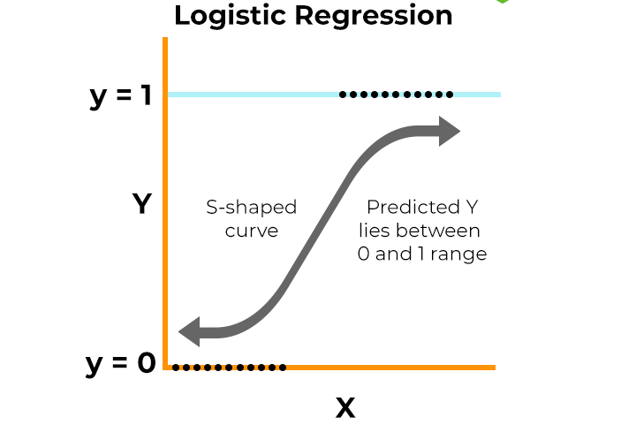
Machine Learning Algorithm
Logistic Regression
Logistic regression is a supervised machine learning algorithm used for classification tasks where the goal is to predict the probability that an instance belongs to a given class or not.
Logistic regression is a statistical algorithm which analyze the relationship between two data factors.
Logistic regression predicts the output of a categorical dependent variable. Therefore, the outcome must be a categorical or discrete value.
It can be either Yes or No, 0 or 1, true or False, etc. but instead of giving the exact value as 0 and 1, it gives the probabilistic values which lie between 0 and 1.

Slide 12
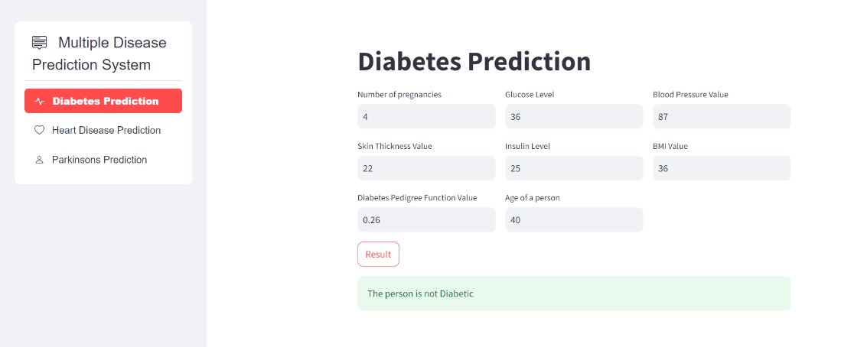
Diabetes Disease Prediction
Diabetes is a chronic condition characterized by high blood sugar levels, which can lead to severe health complications if not managed properly.
For diabetes disease prediction, SVM machine learning algorithm was used.
Features: No. of Pregnancies , Age , Glucose levels, blood pressure, BMI, Insulin, Skin Thickness, Diabetes Pedigree Function (Family history).

Slide 13
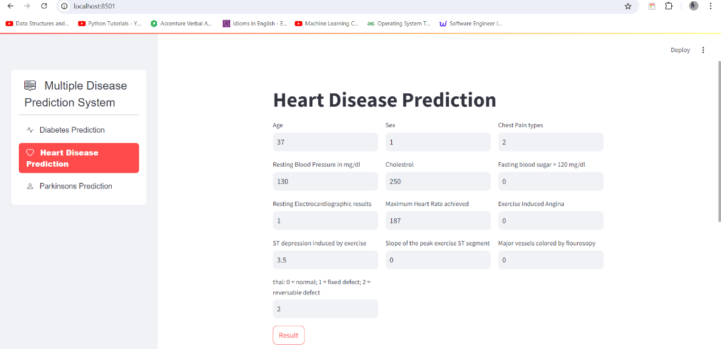
Heart Disease Prediction
Heart disease is one of the leading causes of death worldwide, often resulting from factors such as high blood pressure, cholesterol levels, smoking, and obesity.
Early detection is crucial for effective treatment and prevention.
The project uses Logistic Regression method to predict the disease.
Features: Age, Sex, Chest Pain types, Resting Blood pressure, Cholesterol , Fasting Blood Sugar, Resting ECG results, Max heart rate, Slope of the peak exercise.

Slide 14
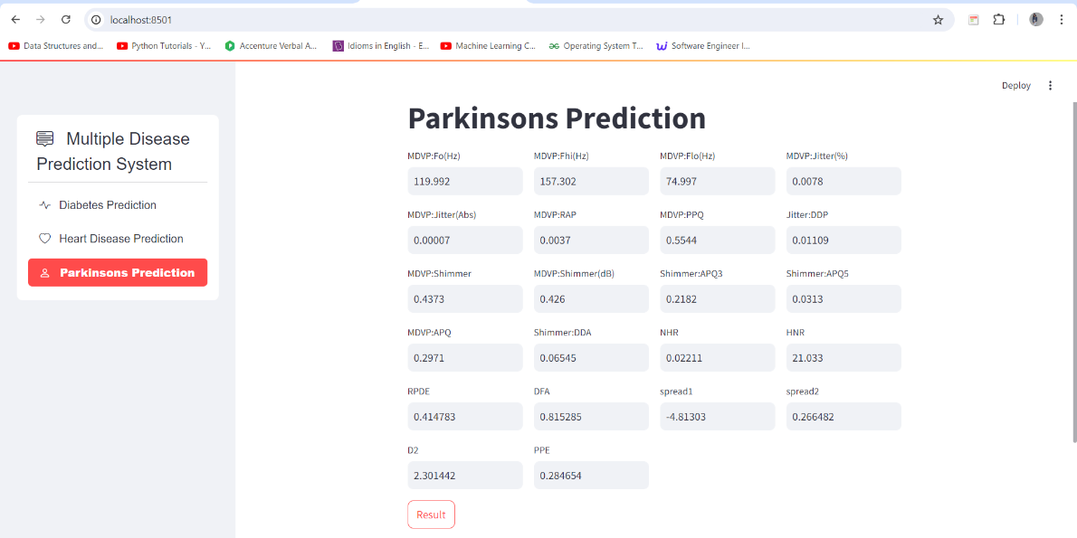
Parkinson’s Disease Prediction
Parkinson’s disease is a progressive neurological disorder that affects movement, causing symptoms such as tremors, stiffness, and difficulty with balance and coordination.
The model utilizes SVM to classify whether an individual is likely to have Parkinson’s disease based on these features.
Features: voice measurements, such as pitch variation, jitter, and signal-to-noise ratio, which are indicative of the disease.

Slide 15
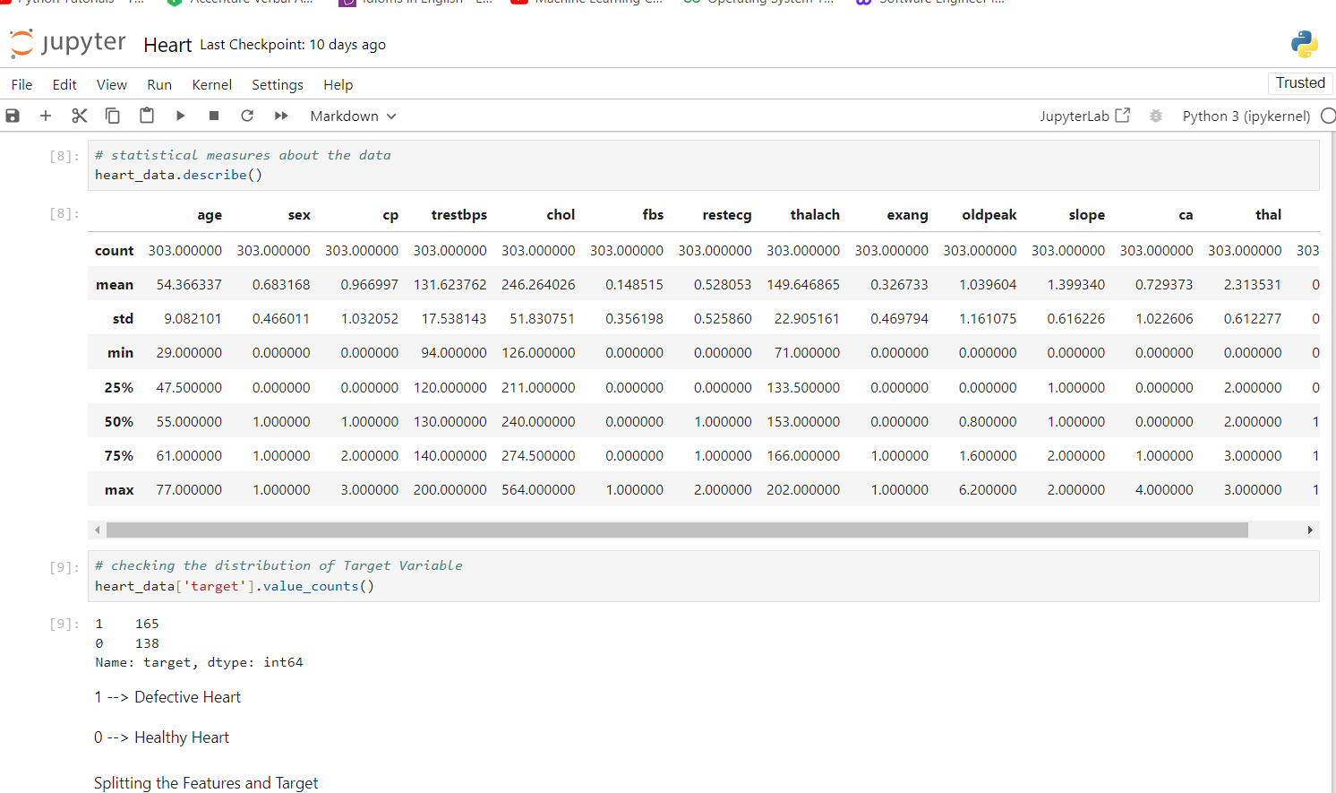
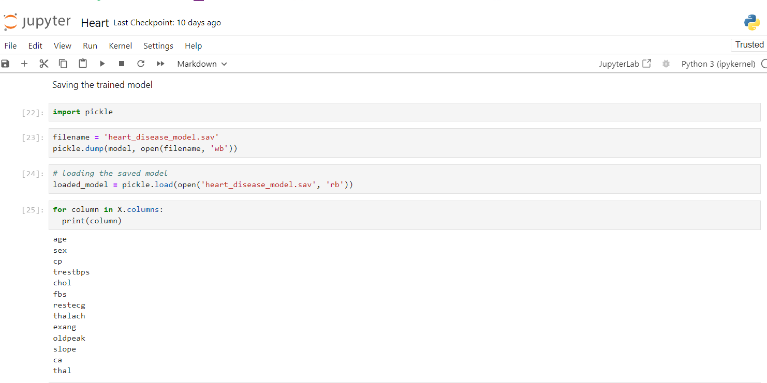
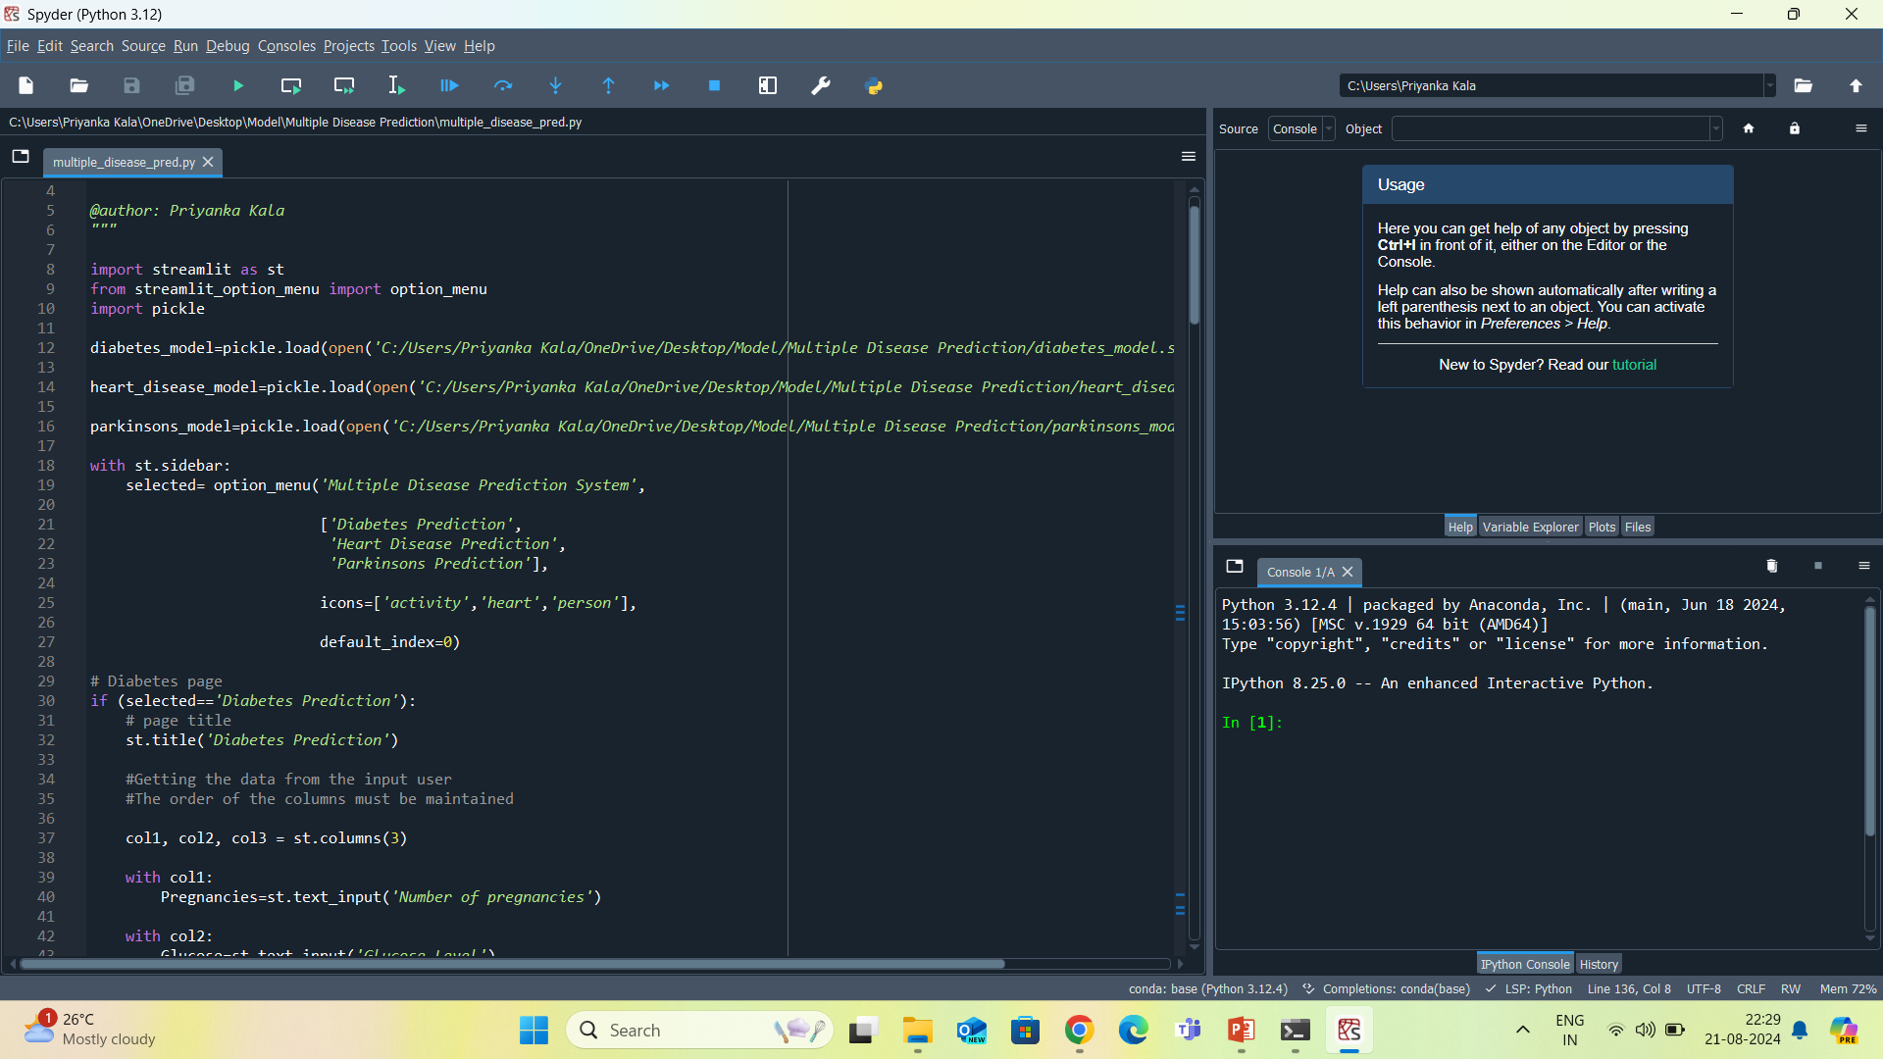
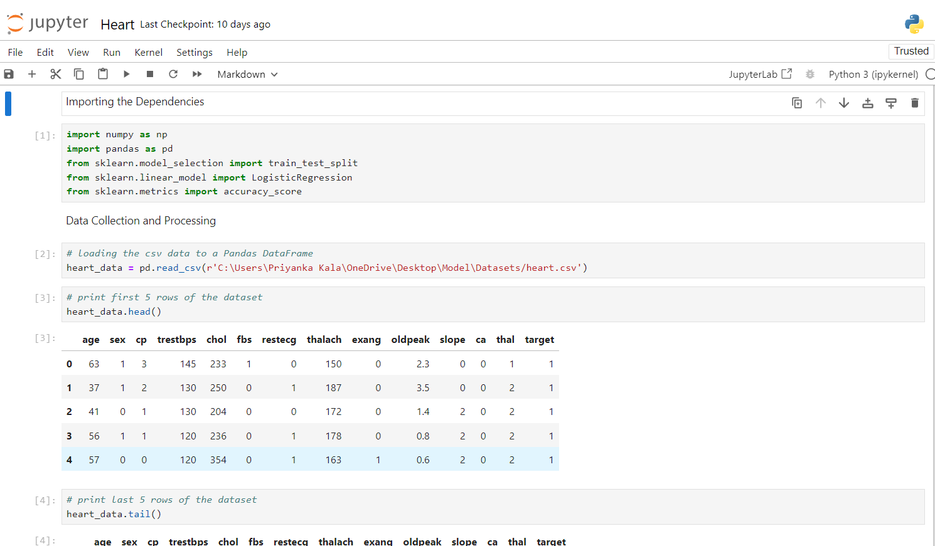
Training the Model

Slide 16
Result and Analysis
Disease | Accuracy
Diabetes | 98.25 %
Heart | 85.23 %
Parkinson | 77.2%
KEY POINTS :
The data was split into training and testing data with 4:1 ratio.
Spyder IDE was used for implementing the Streamlit interface and Jupyter Notebook for training the models.
The data has been standardized and normalised which has eliminated the risk of missing values or null entries.
The features selected were best fit for predicting the diseases.

